Slide 1
Power BI Adoption Framework
Empower every decision maker
What to manage?

Slide 2



Azure Active Directory
PowerBI.com
Administration
Directory Synchronization
Manage Domains and Accounts
Manage login branding
Office 365
Directory and Account management
Subscriptions and licenses
Creating groups and organization apps
Enterprise IT management, usage monitoring and admin portal
Manage Subscriptions
License Assignment
Manage Domains and Accounts
Power BI
Create Workspaces
Create Apps
Tenant Settings
Monitoring
Manage gateways
Premium Capacity Management

Slide 3
Who is responsible for creating security groups?
Options
Office 365 Administrators
Azure Active Directory Administrator
Support Team

Slide 4
App Workspaces Creation Options
Option | Pros | Cons | Actions
Allow all users to create App Workspaces (Recommended) | Can be created whenever required | Can lead to lots of App workspaces | Monitor App Workspaces to identify unused workspaces and remove
Restrict to specific group of individuals | Groups creation can be validated | Delay in requesting a new workspace to be created | Define List of approved individuals and approvers Restrict group creation in O365 to above individuals Create Group request mechanism Update Tenant Setting Monitor App Workspaces to identify unused workspaces and remove

Slide 5
When to create an App Workspaces - Recommended
Option | How Many | Reasoning
BI Team Development | 1 | All Reports / Dashboards can be developed in 1 location Collaborative development area
BI Team Test | 1 | All Reports / Dashboards can be developed in 1 location Collaborative development area
BI Team QA | 1 per report category | Only 1 App can be created per Workspace Need to test App experience
BI Team Production | 1 per report category | Only 1 App can be created per Workspace Need to share with different audiences
Business Self-Service Development | 1 per department | Separate reports created by different departments Collaborative development area within a department
Business Self-Service Production | 1 per report category | Only 1 App can be created per Workspace Need to share with different audiences

Slide 6
When should workspaces be created?

Slide 7
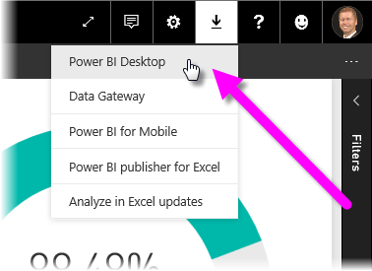
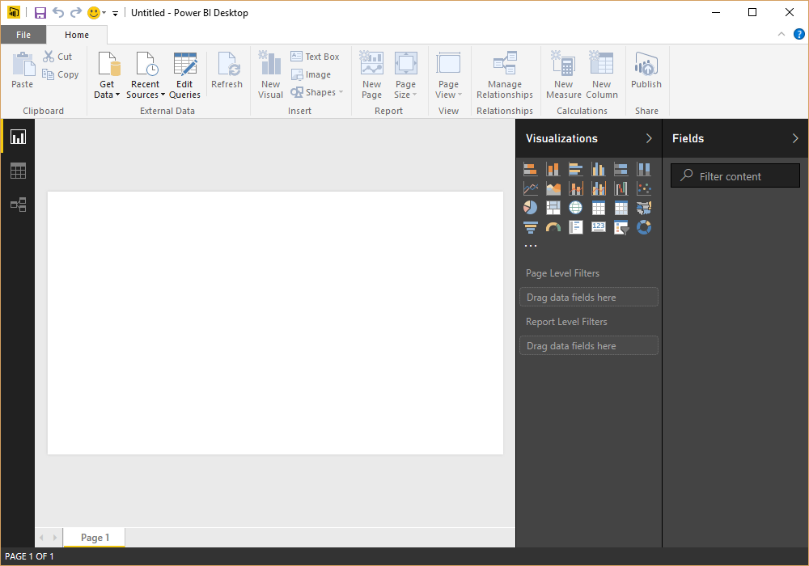
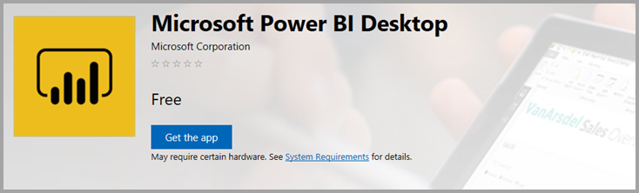
Power BI Desktop
Monthly Updates
Download from PowerBI.com
Packaged deployment from IT
Download from Windows Store

Slide 8
How will you manage installing Power BI Desktop?
Option | Pros | Cons | Actions
Windows 10 Store (Recommended) | Updates automatically installed Administrative privileges are not required. Download sizes are smaller Can be integrated with an organization’s roll-out policies and available via Microsoft Store for Business. | Less controls than System Center Configuration Manager. Requires Windows 10. | Sign up for Store for Business Decide on whether to distribute through the Store or a management tool Configure Store Add Power BI App and allow access to relevant individuals Users install Power BI Desktop from Microsoft Store.
Manually download and install | Timing controlled by the owner of the PC. | Requires administrative rights User machines may be out of sync, leading to compatibility issues. Every update requires action by the owner of the PC. | Make sure all relevant users are Admins
Organizational IT deployment tools such as Microsoft System Center Configuration Manager | The process is managed and handled by the organizational IT dept. | More complex. | Create package Agree frequency for package updates
Install Power BI on a Virtual Machine | The process is managed and handled by the organizational IT dept. Can easily update Can install additional items, e.g. drivers, R / Python, if required Offers the most control. | Need to provision, monitor and manage a Virtual Machine | Request Virtual Machine Build image for Virtual Machine, which includes required software and spec Make user an admin to allow them to install new updates

Slide 9
How will users install drivers on their machines (if required)?
Options
Manually Download and Install
Organizational IT deployment

Slide 10
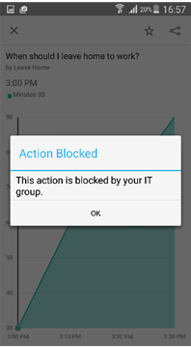
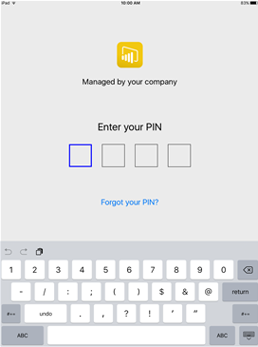
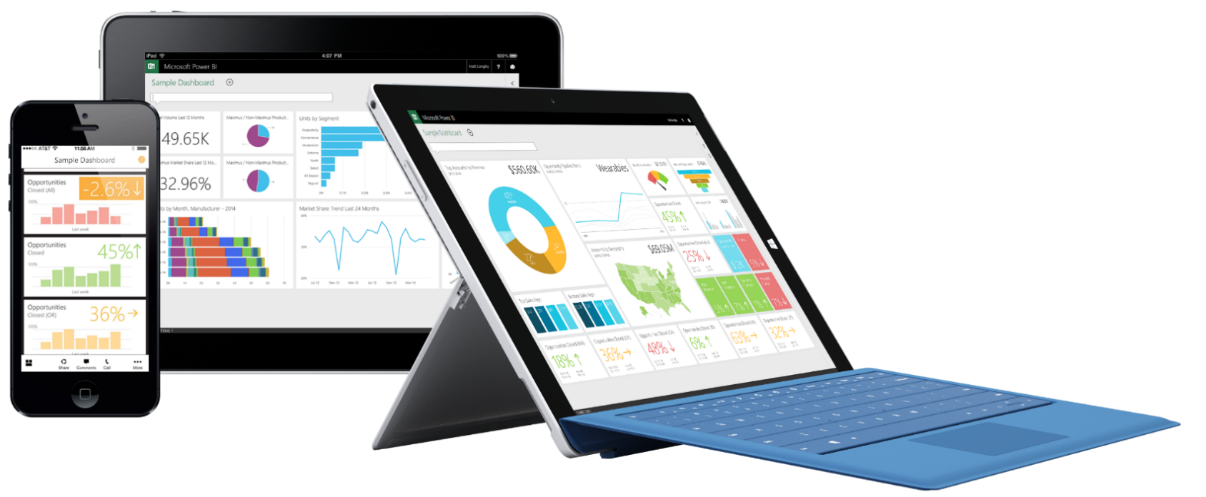
Mobile BI
Administration
Enterprise Mobile Device Management and app access control
Integrated InTune mobile application management (MAM) capabilities
Better control access to the data
Prevent data leakage

Slide 11
Do you want to manage mobile devices?
Options
Microsoft Intune
Other Mobile Application Management Tool
None

Slide 12
Who will be responsible for administering Power BI Mobile?

Slide 13
Marketplace Offerings

Slide 14
Azure Active Directory
PowerBI.com
Administration
Directory Synchronization
Manage Domains and Accounts
Manage login branding
Office 365
Directory and Account management
Subscriptions and licenses
Creating groups and organization apps
Enterprise IT management, usage monitoring and admin portal
Manage Subscriptions
License Assignment
Manage Domains and Accounts
Power BI
Create Workspaces
Create Apps
Tenant Settings
Monitoring
Manage gateways
Premium Capacity Management

Slide 15
Do you want to manage mobile devices?
Microsoft Intune
Set up Intune
Configure Power BI for use with Intune
Get URL for iOS and/or Android application
Create Mobile Application Management policy
Create the application
Deploy the application
Install the application on appropriate devices
Other Mobile Application Management Tool
Confirm tool can be used to administer Power BI Mobile
Configure Power BI Mobile
Install the application on appropriate devices
No
No action required

Slide 16
Thank you

